Slide 1
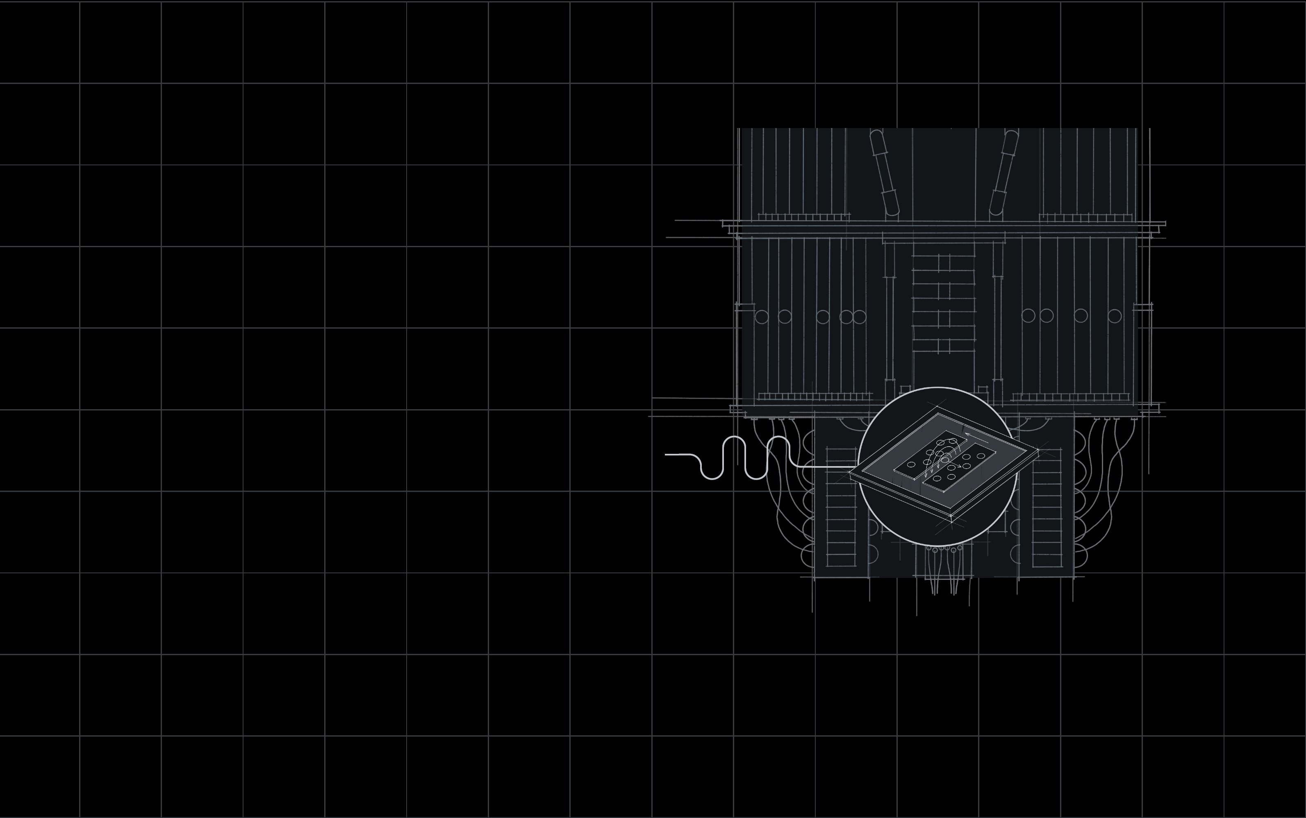
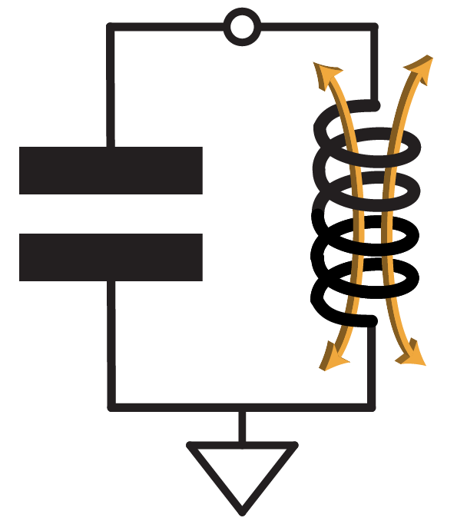
Qiskit Metal
Why is the quantum community excited?
Project Qiskit Metal
Open source
Slack
qiskit.org/metal
github.com/Qiskit/qiskit-metal
qiskit.slack.com
#metal
IBM Quantum
Priti Shah – Software Engineer

Slide 2
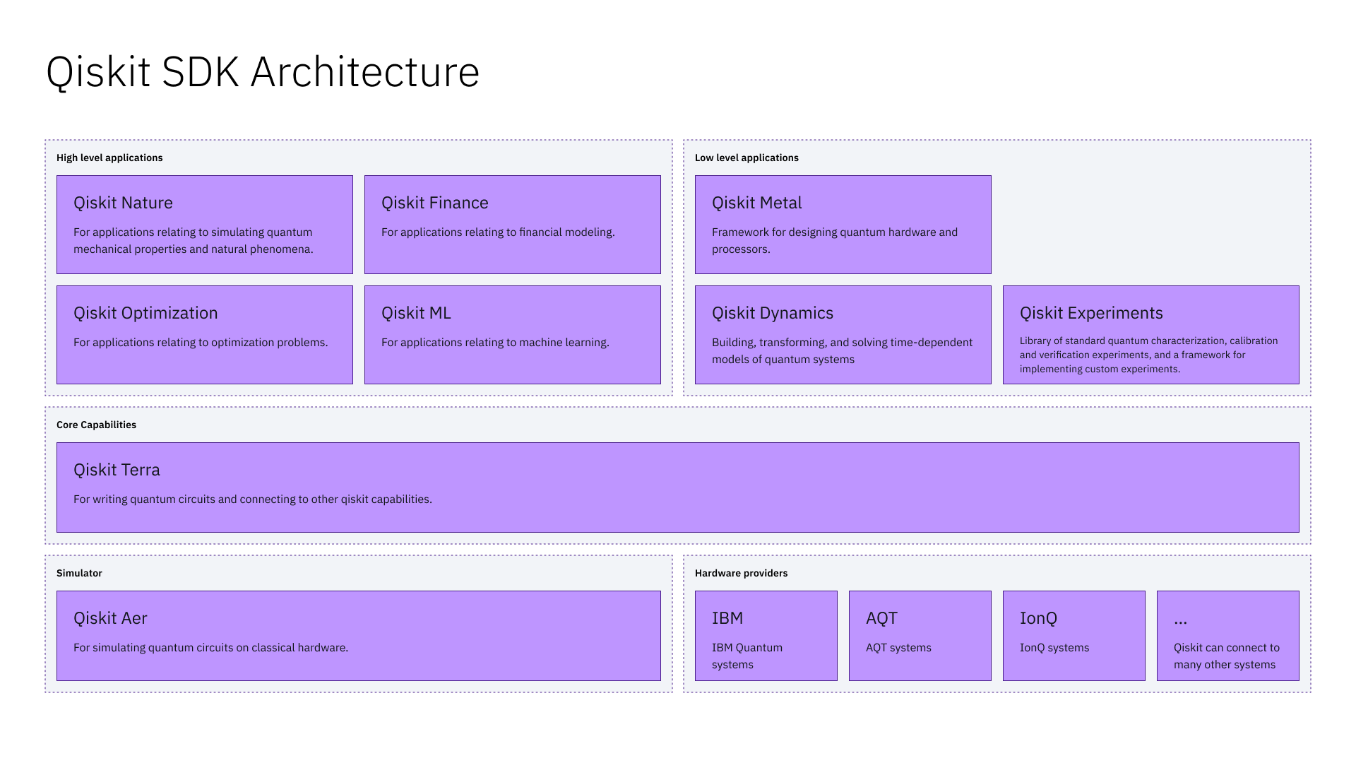

Metal in Qiskit SDK Architecture

Slide 3

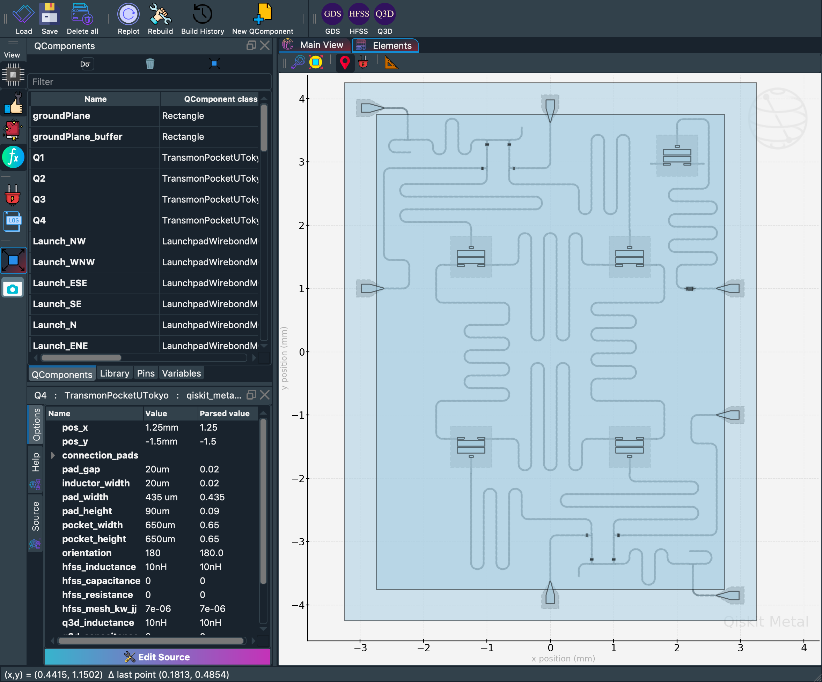

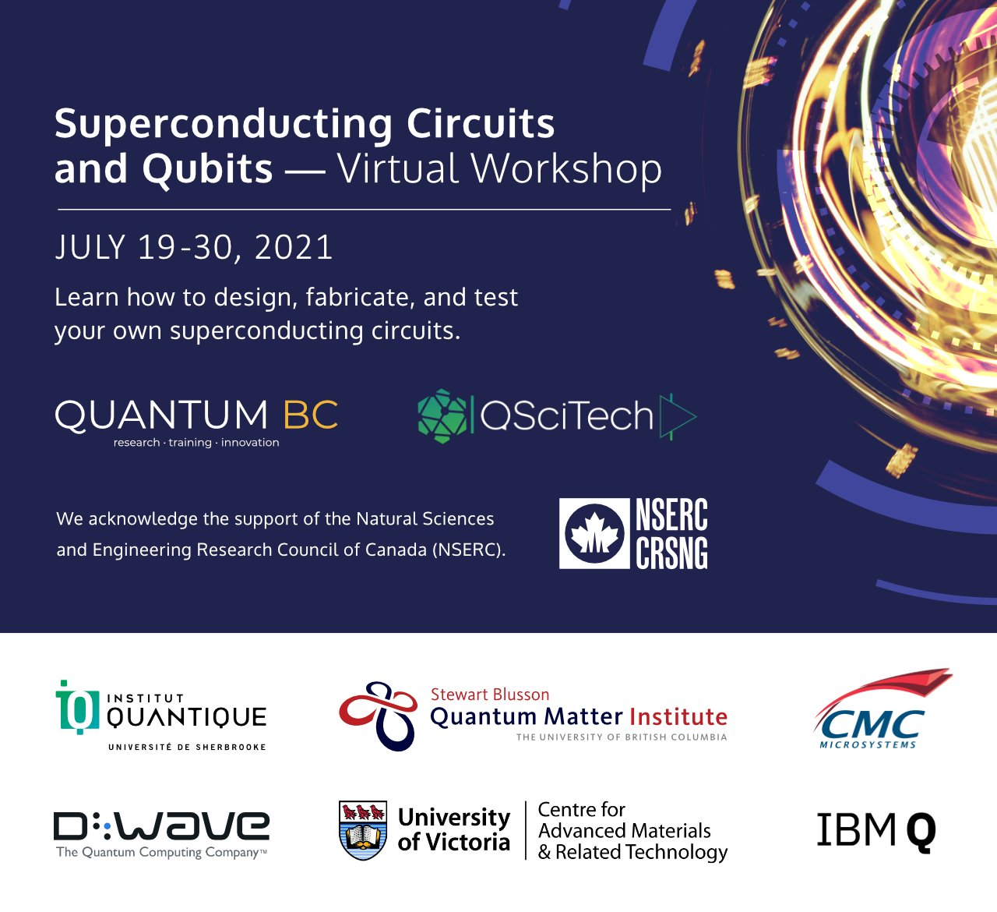
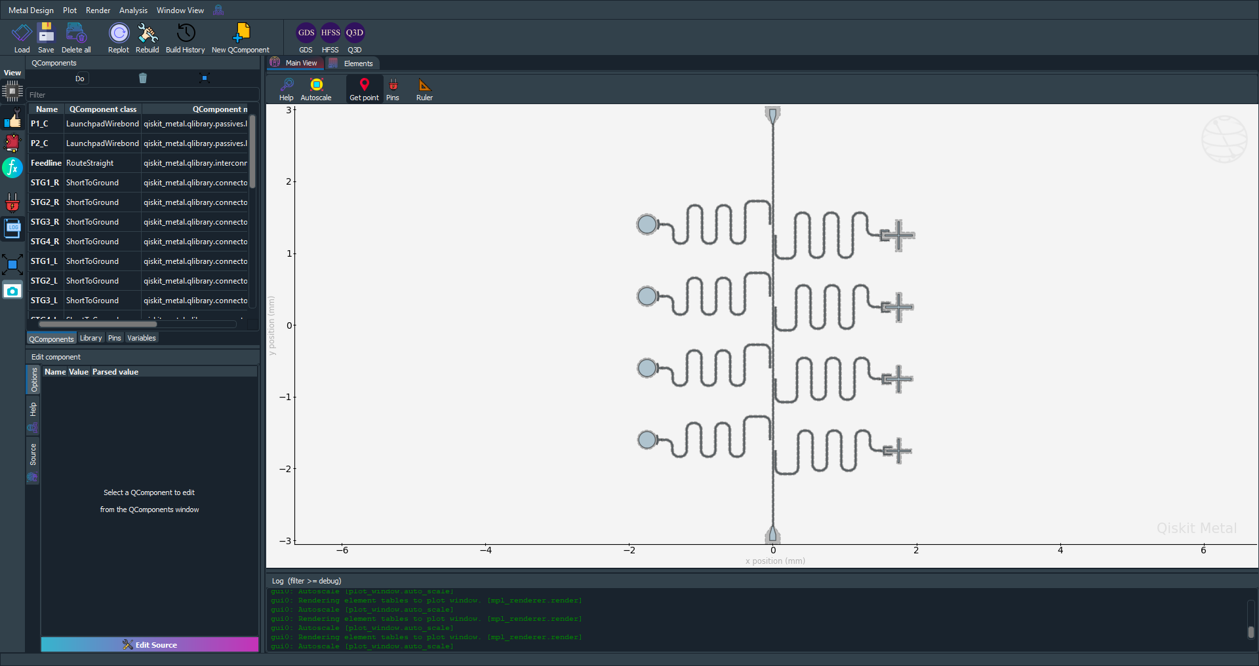

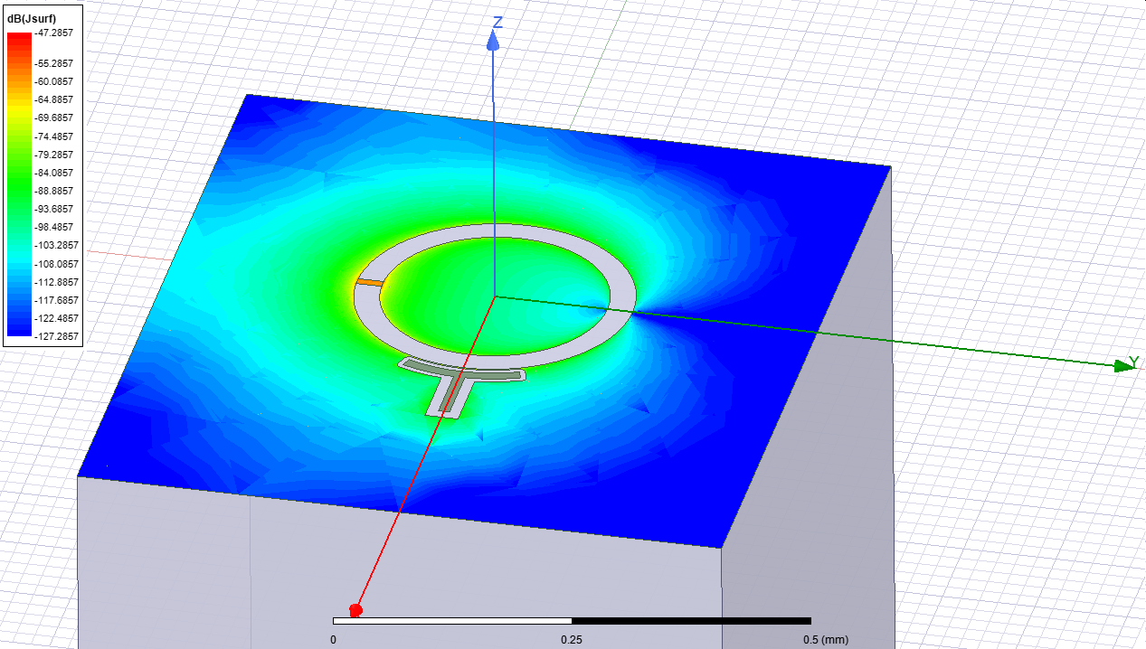
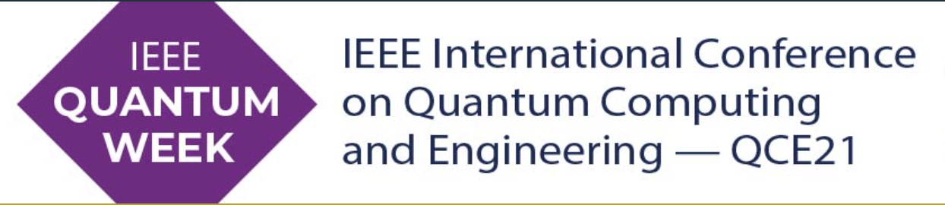

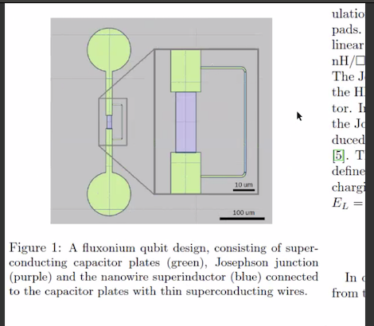
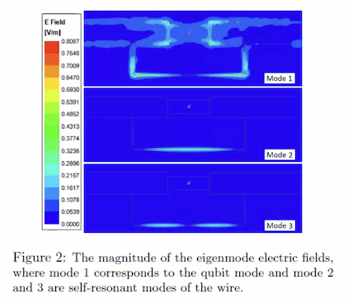

Qiskit -Metal is being used by researchers
Devices
Conferences
Education
IBM 4Q Tsuru UTokyo
Chalmers 8Q
TU Delft Fluxonium

Slide 4
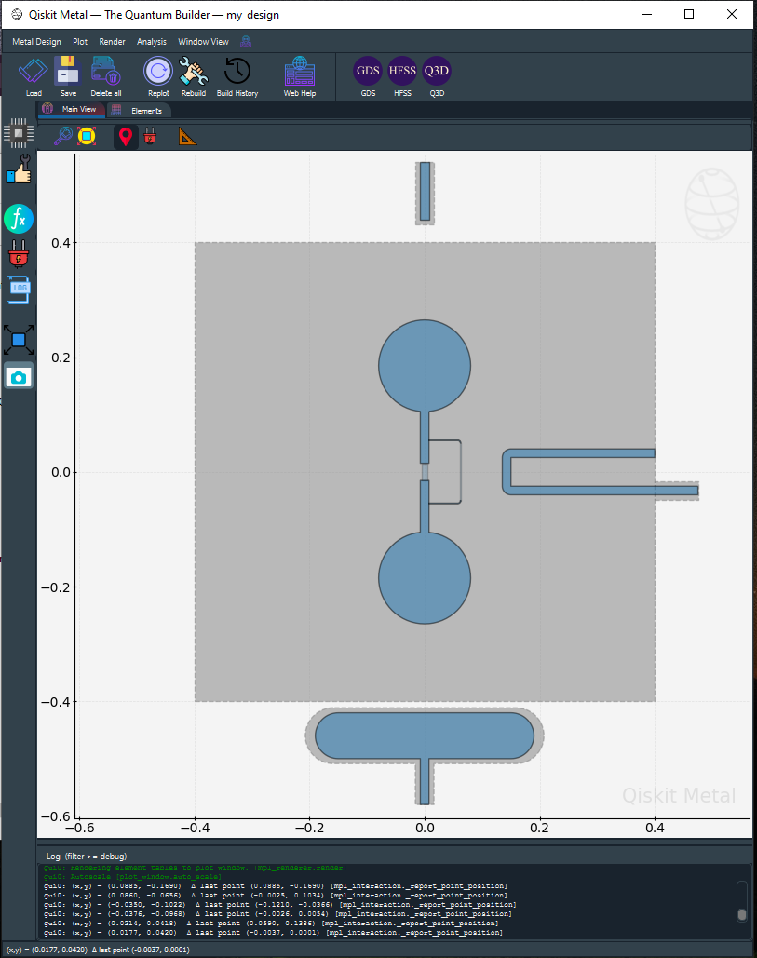
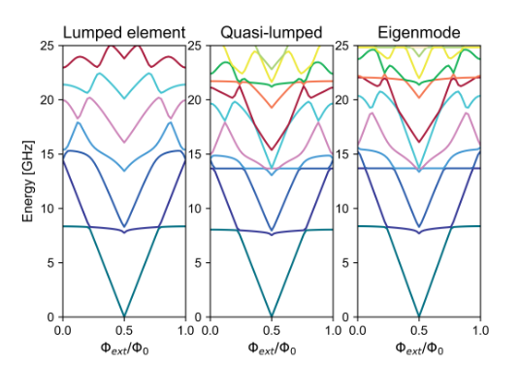
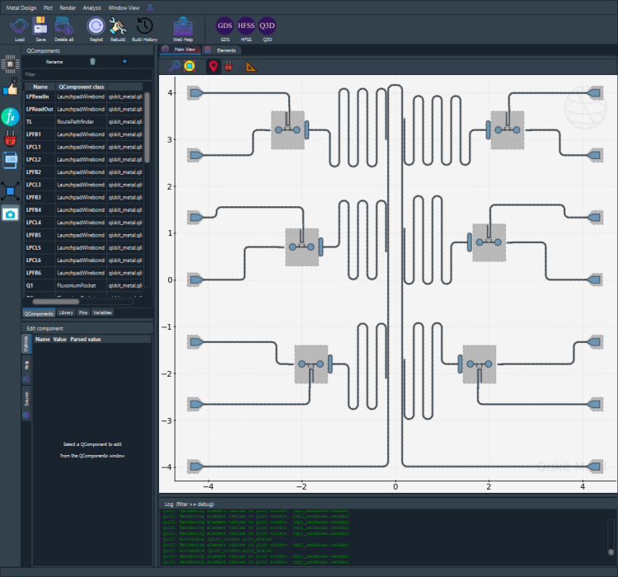
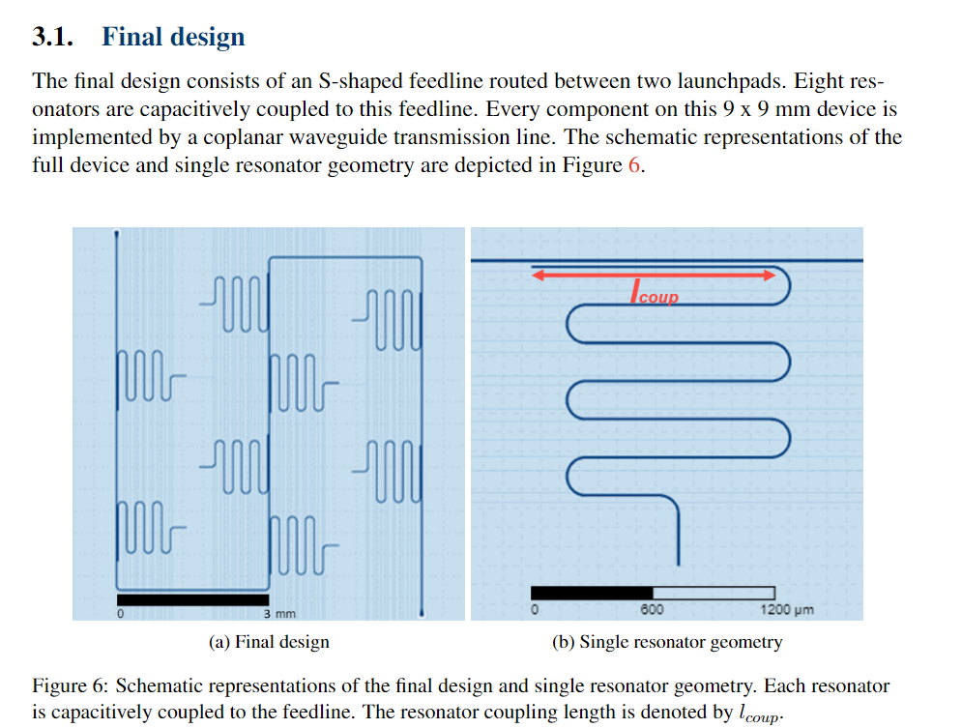
Qiskit -Metal is being used by researchers, cont’d.
QuTech / Technische Universiteit Delft , Anderson Lab
Figen Yilmaz:
Fluxonium chip design
Roald van den Boogaart:
Fluxonium spectrum
Extended the analysis methods to handle fluxonium qubits
Intermediate chip design.
Sara Buhktari:
Fabricated resonator design being measured
“Qiskit-Metal is the best tool if one studies superconducting qubits” by Figen Yilmaz.

Slide 5

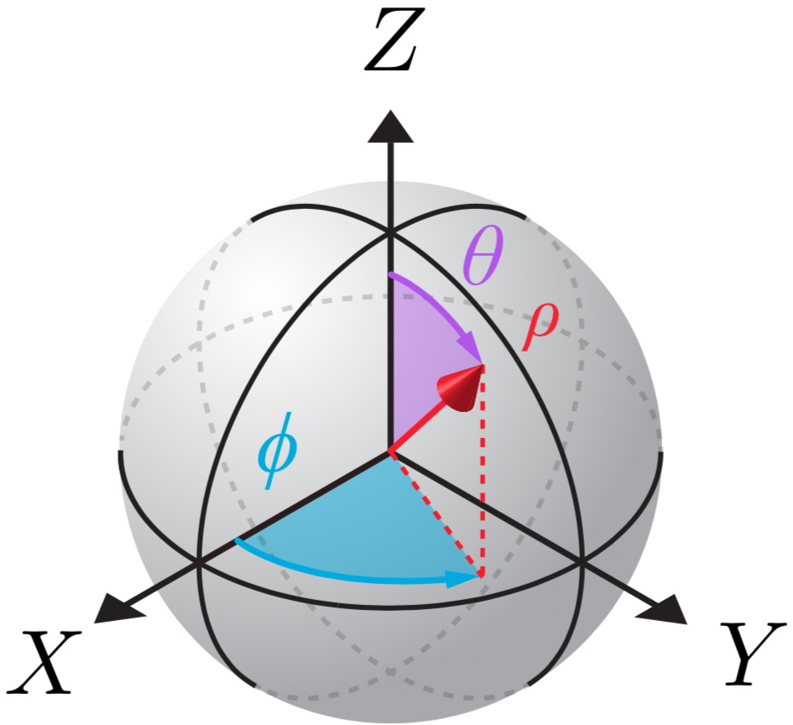
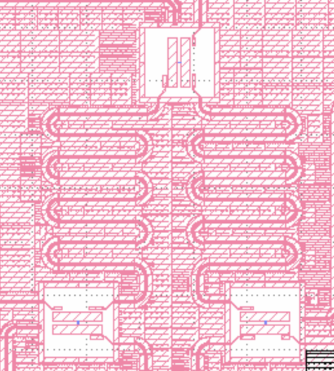
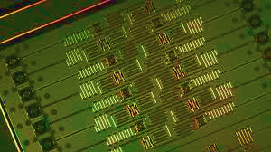




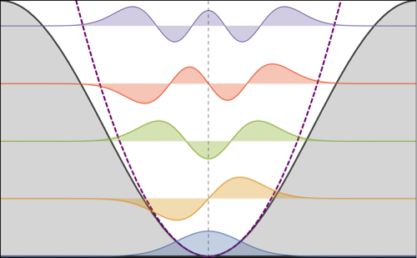
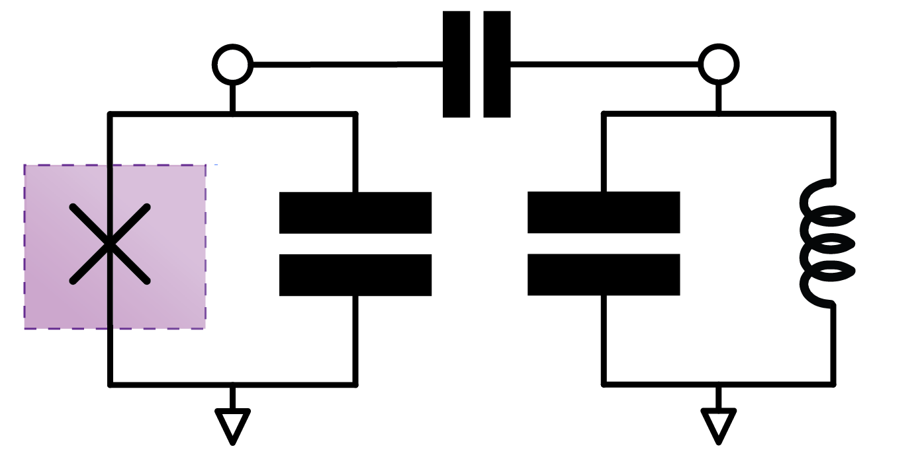
Quantum chip design flow
Complexity, Information, Accuracy
Risk, Cost, Time, Resources
Concept
Hamiltonian
Layout
Fabrication
Quantum Analysis
Electromagnetic
Simulations
IBM Quantum / © 2022 IBM Corporation

Slide 6


Quantum chip design flow
Complexity, Information, Accuracy
Risk, Cost, Time, Resources
Concept
Hamiltonian
Layout
Fabrication
Quantum Analysis
Electromagnetic
Analysis
IBM Quantum / © 2022 IBM Corporation

Slide 7
Qiskit Metal Framework
Scripting Interface
(e.g., Jupyter Notebook)
Front-End User
GUI
Metal Analysis Library
Metal Analysis
Creator User
Metal Component Library
Metal Core API qdesign, qcomponents, qgeometry
Metal Design Library
qgeometry Library
Plugin Developer
Metal Renderer Library
Metal Renderers
multi-target layout compiler
External API
External API
External file structure (e.g. GDS)
Commercial Software
Commercial Software
IBM Quantum / © 2022 IBM Corporation

Slide 8
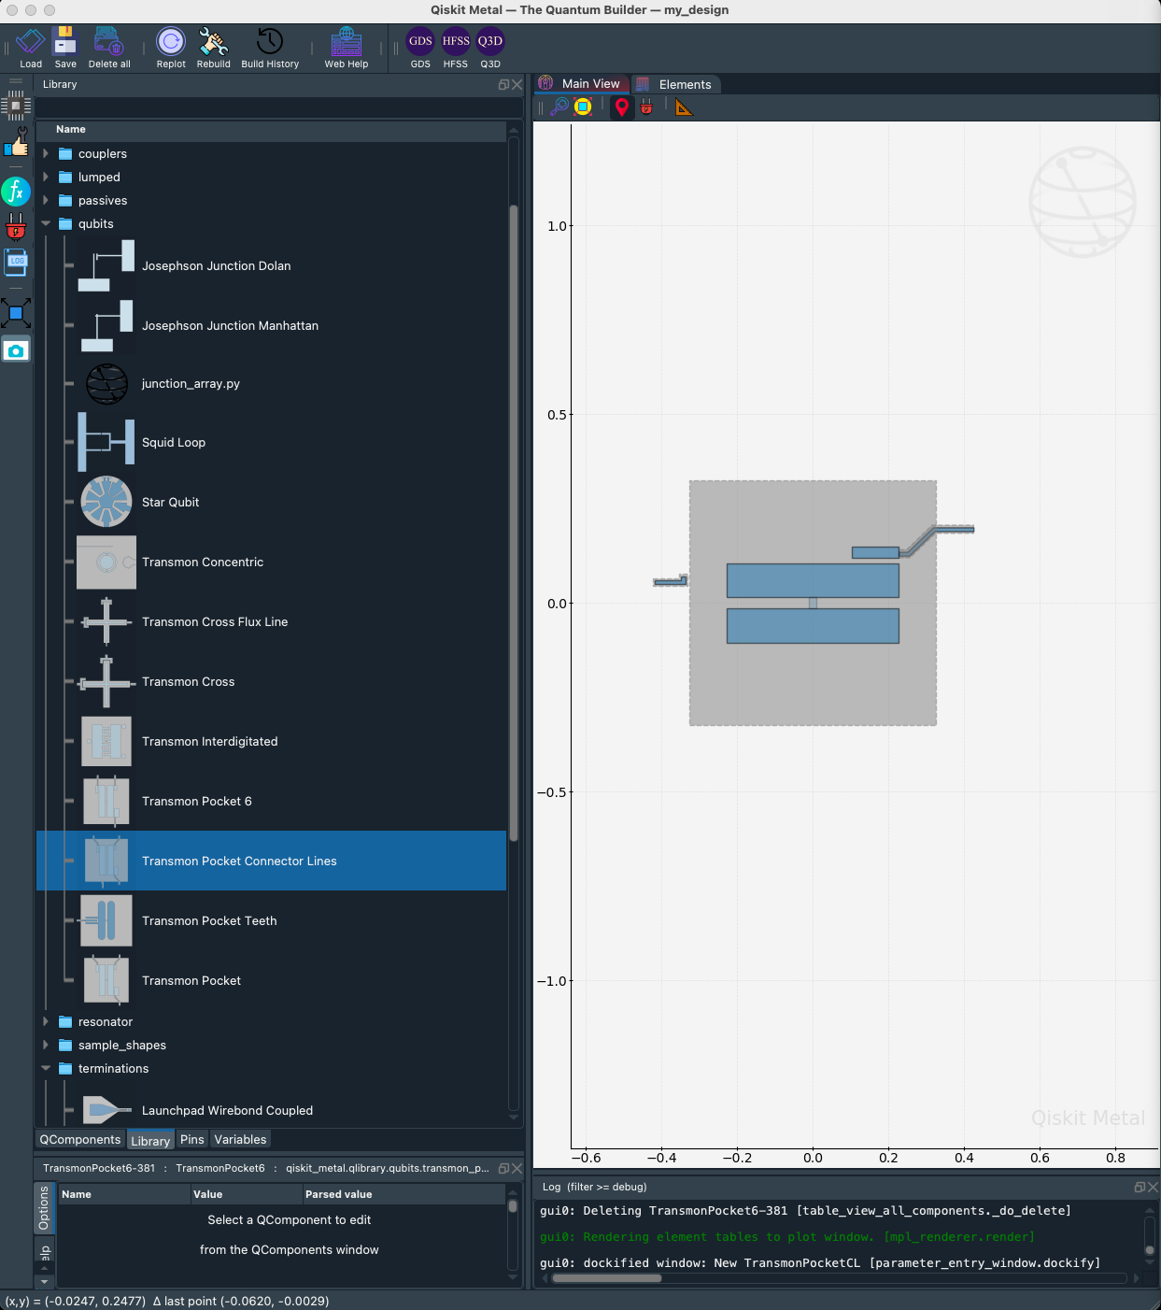
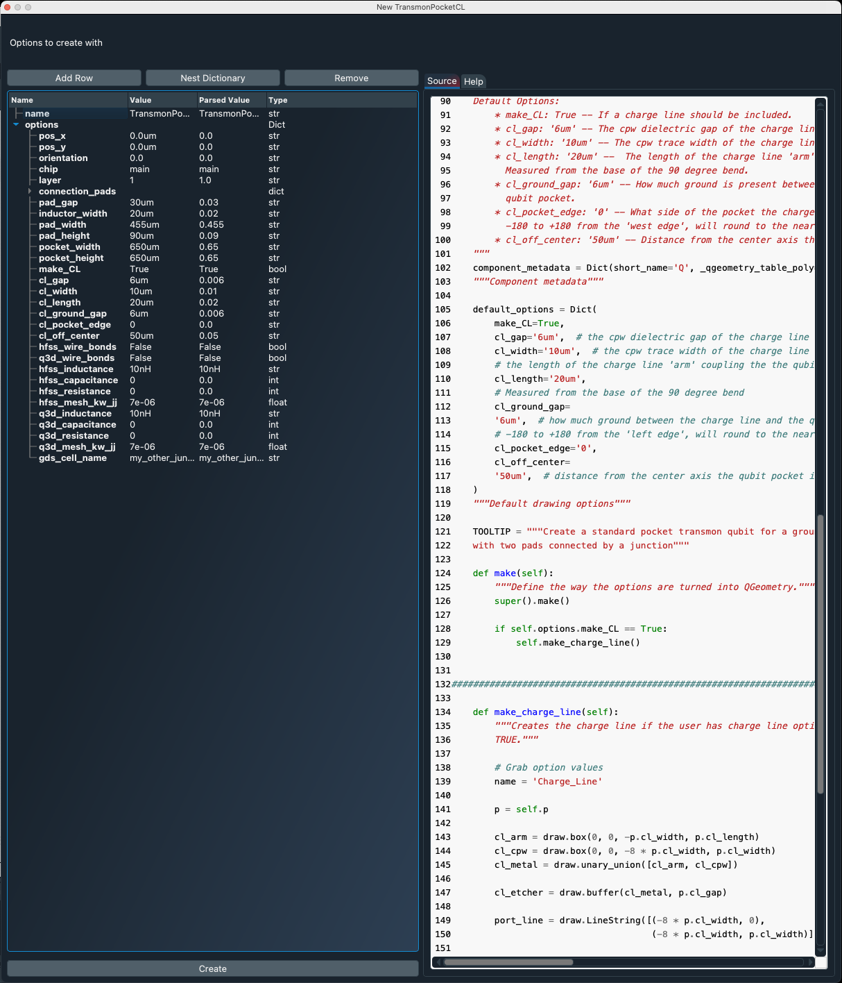
You can make your component from scratch or edit components from our growing library.
Example:
Qubit in GUI with
options which are parametrized.
Python class for every kind of component, defined within a design for a chip.

Slide 9
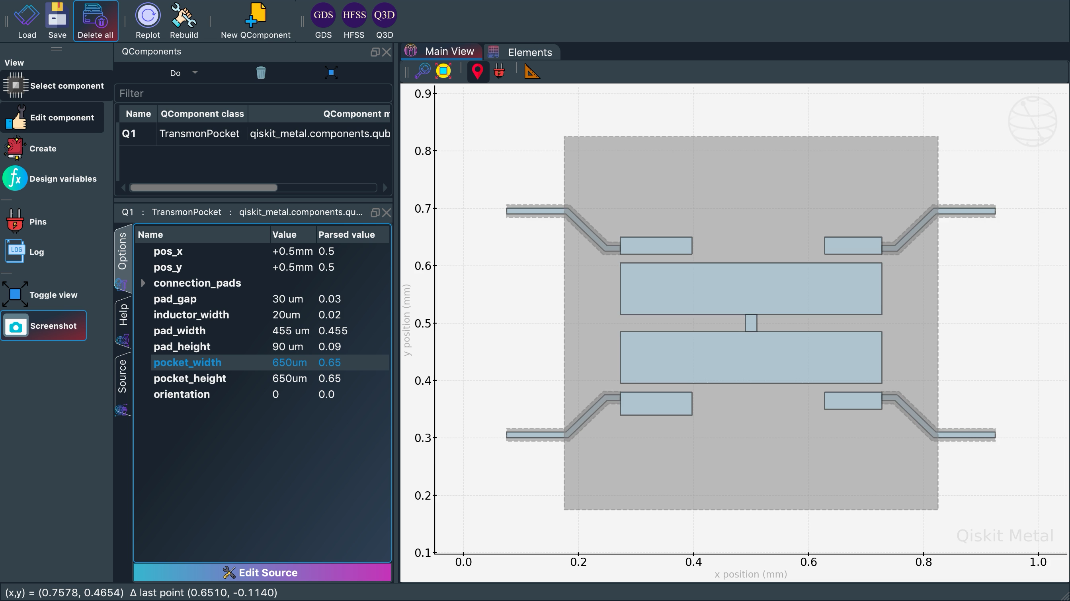
Fine-tune and automate parameters
pocket_width
pad_width
inductor_width
pad_height
pad_gap
pos_x
pos_y
pocket_height
orientation

Slide 10
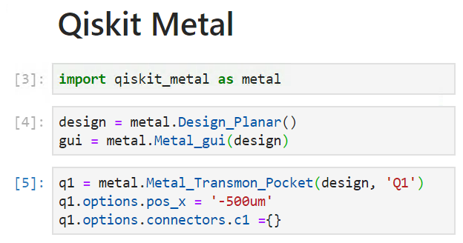
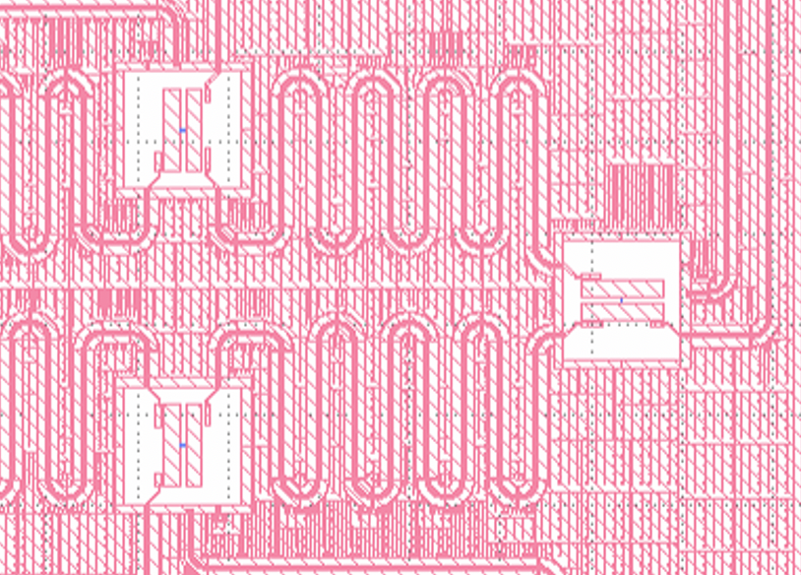
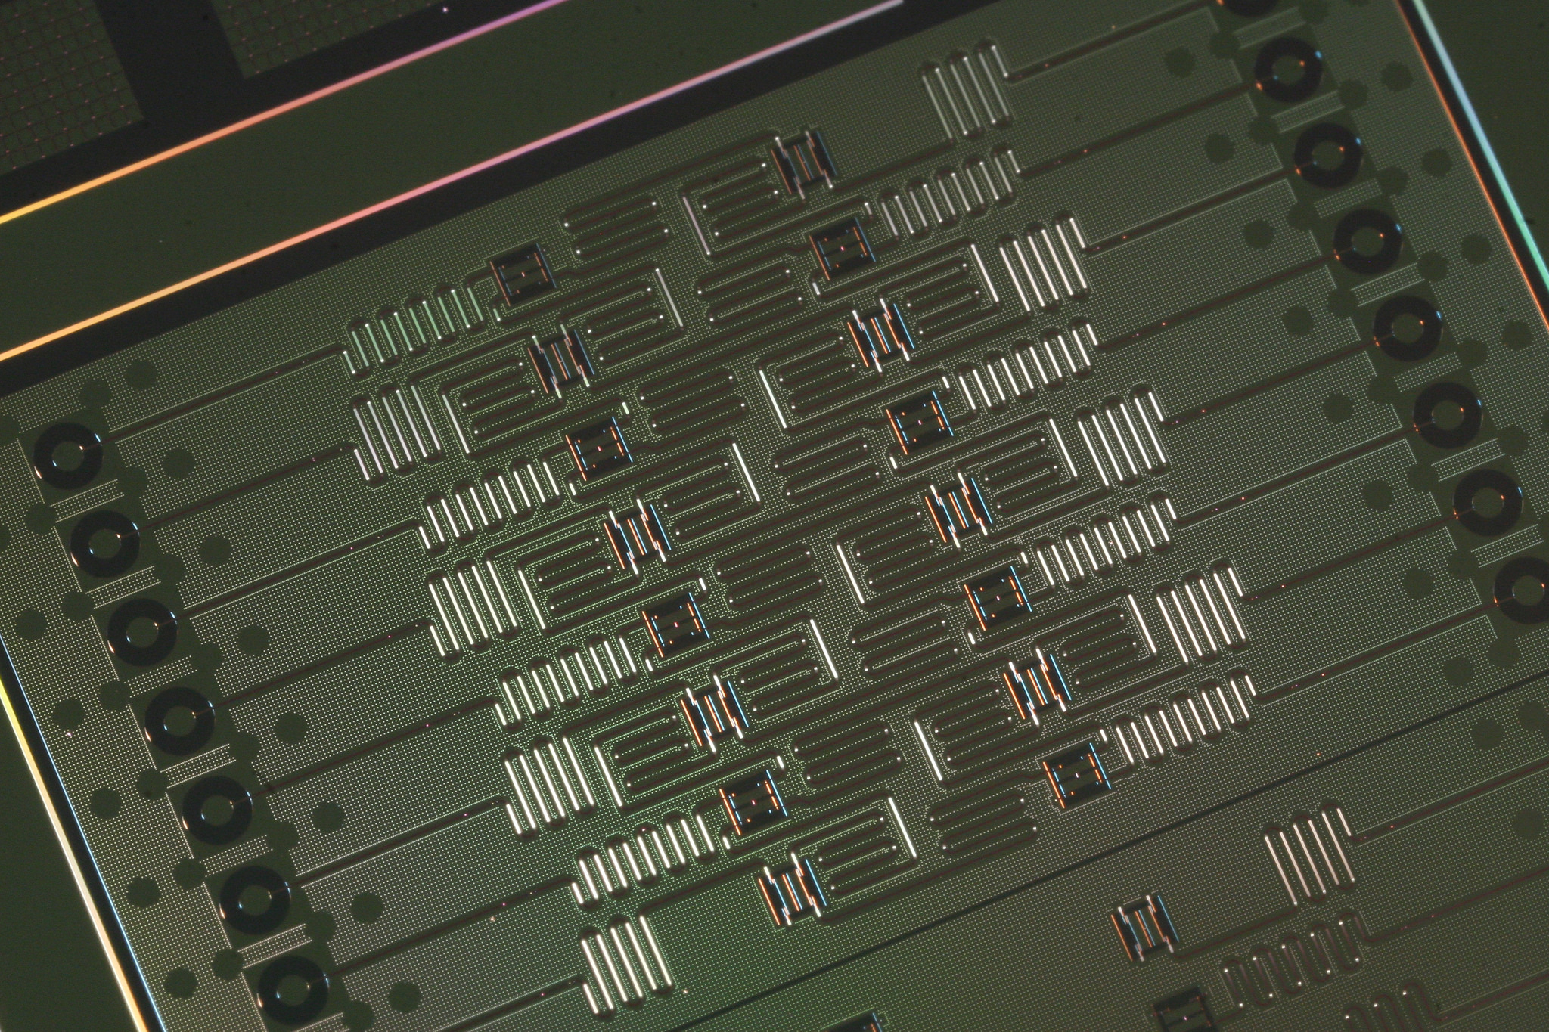
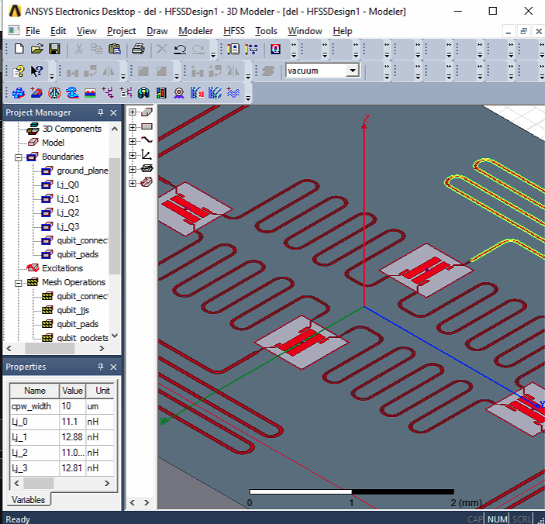
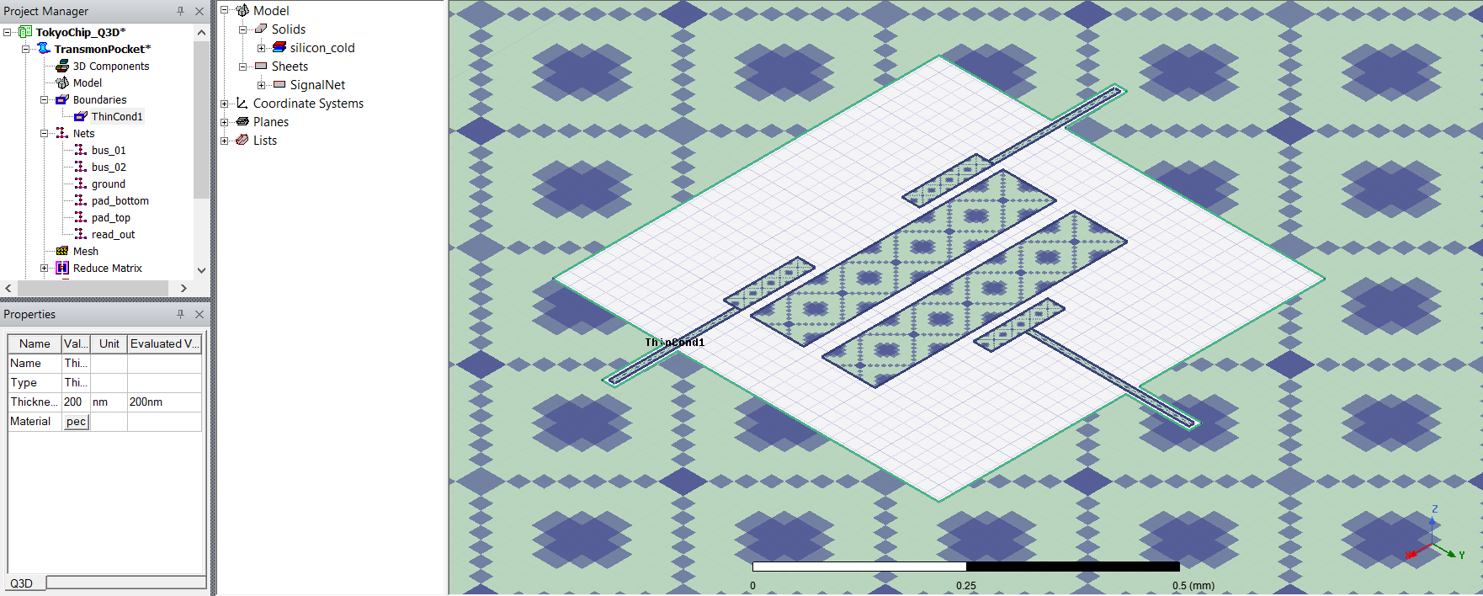

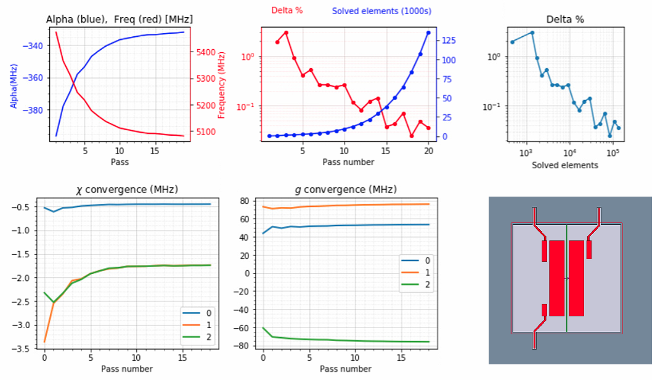
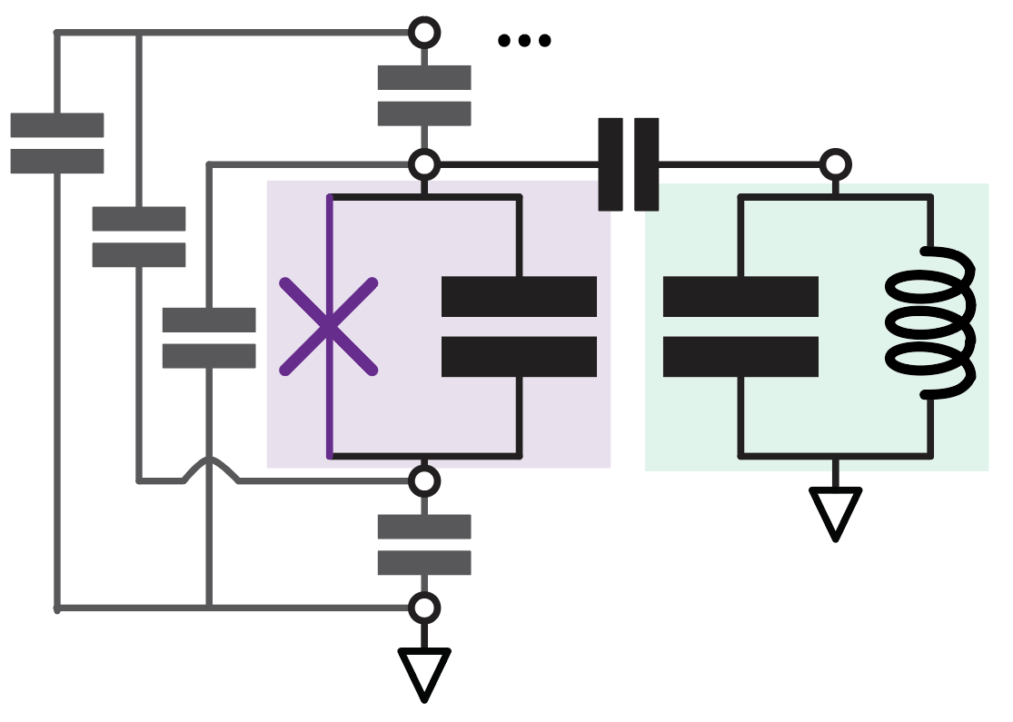
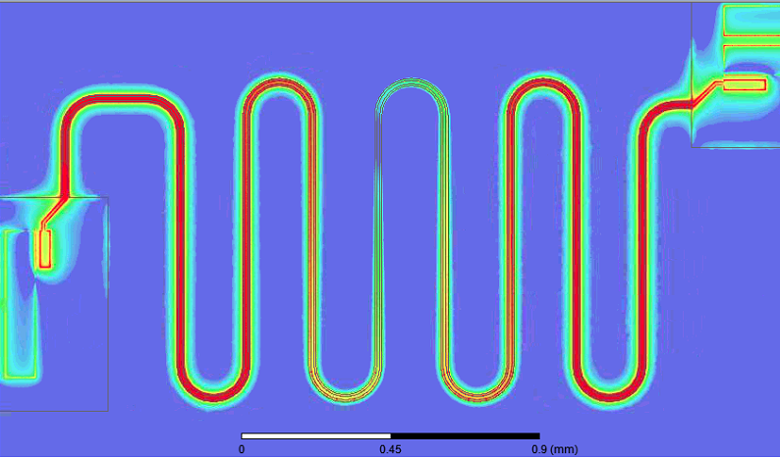
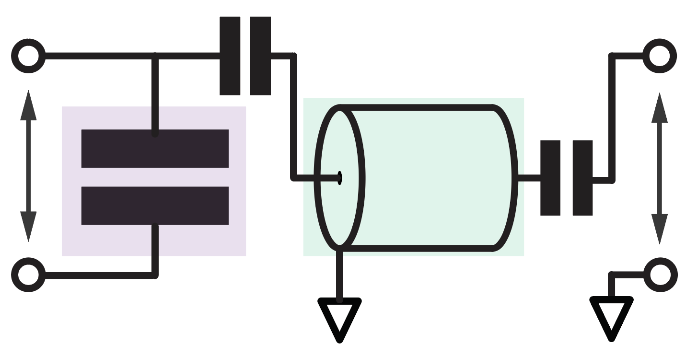
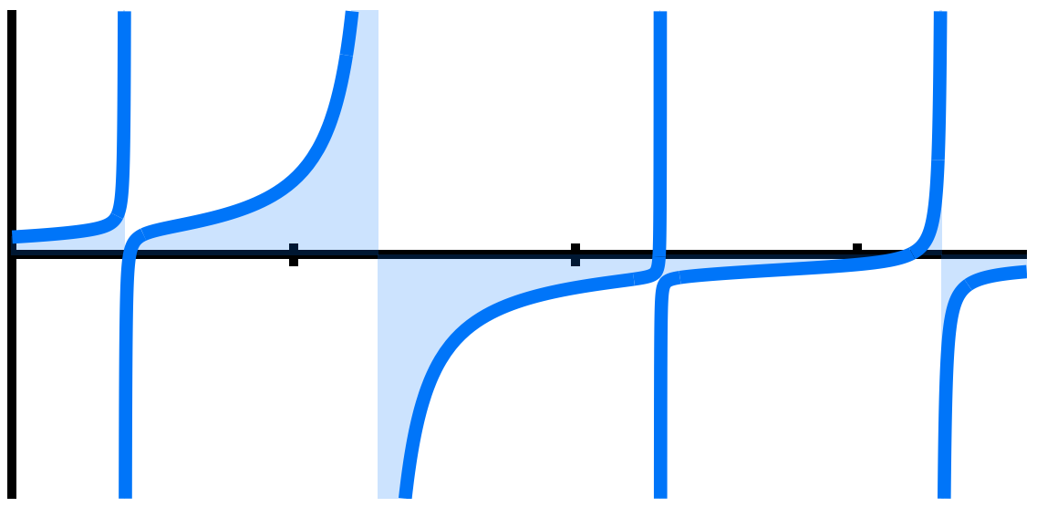
Flow
Final mask and device
GDS / DRC
External Simulation Tools
EM simulations
Metal
DRC
Layout external tools and procedures / checks
Ansys HFSS
Ansys Q3D
Keysight
and
others
Metal
Layout
Metal
Simulations
Reports
Chip performance and reports
Metal
Reports
Metal
Analysis
Core user
[person]
A quantum-chip designer, simulator, or theorist. Uses ready features or extends.
Quantum analysis tools
Based on EM simulations
Lumped
Eigenmode
Semi-analytic
Impedance
IBM Quantum / © 2021 IBM Corporation

Slide 11
Quantum Analysis Techniques Being developed; some techniques are not shared with community.
LOM - Lumped Oscillator Model
EPR - Energy Participation Ratio
Impedance – scattering analysis
Semi Analytic - co-simulation
Qiskit Dynamics - Time Evolution of Gates

Slide 12
Qiskit Metal Why is the quantum community excited?
User identifies parametric inputs, to define components on a chip.
Extensive library of components exists
Qiskit-Metal exports to GDS format
for chip fabrication
Reduce time for development cycle.
Easy to create customized components
Qiskit-Metal integrates your custom-component design with:
Conventional Simulation
Quantum Analysis
Generation of reports

Slide 13
Docs & tutorials qiskit.org/documentation/metal
Tutorial videos YouTube – see docs
Slack #metal (qiskit workspace)
Live tutorials

